Slide 1

Russo-Ukrainian War
Casualties, equipment losses and economic impact
Group – 5
Karma Thapkhey
Kuenzang Tobgay
Passang Dorji
Sonam Dechen Lhaki
23 May 2025

Slide 2
Outline
1
Introduction
2
Aims and objectives
3
Data description
4
Preprocessing
5
Exploratory data analysis
6
Predictive modelling
7
Analysis
8
Conclusion

Slide 3
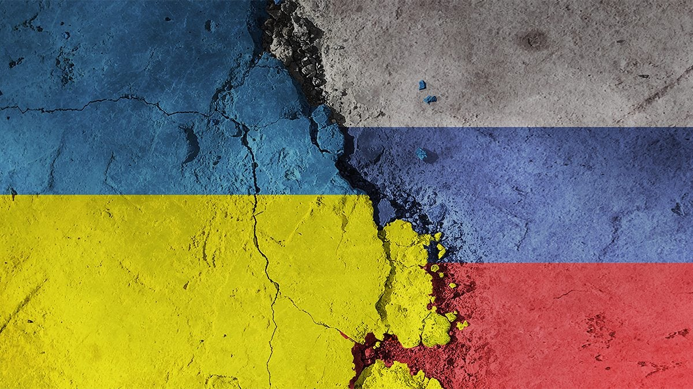
Introduction
Introduction
Russia-Ukraine war (since early 2022) is a major 21st-century geopolitical conflict.
Beyond human and economic toll, it has generated vast, analyzable data.
Focus of analysis:
Equipment losses
Economic/foreign aid
Civilian and military casualties

Slide 4

Aim: To analyze available data to present a clearer picture of the current state of the war, focusing on casualties, equipment losses, and economic costs.
Objectives
1. Compare human casualties (soldiers & civilians).
2. Track military equipment losses (tanks, aircraft, artillery).
3. Estimate economic costs (Various development indicators).

Slide 5
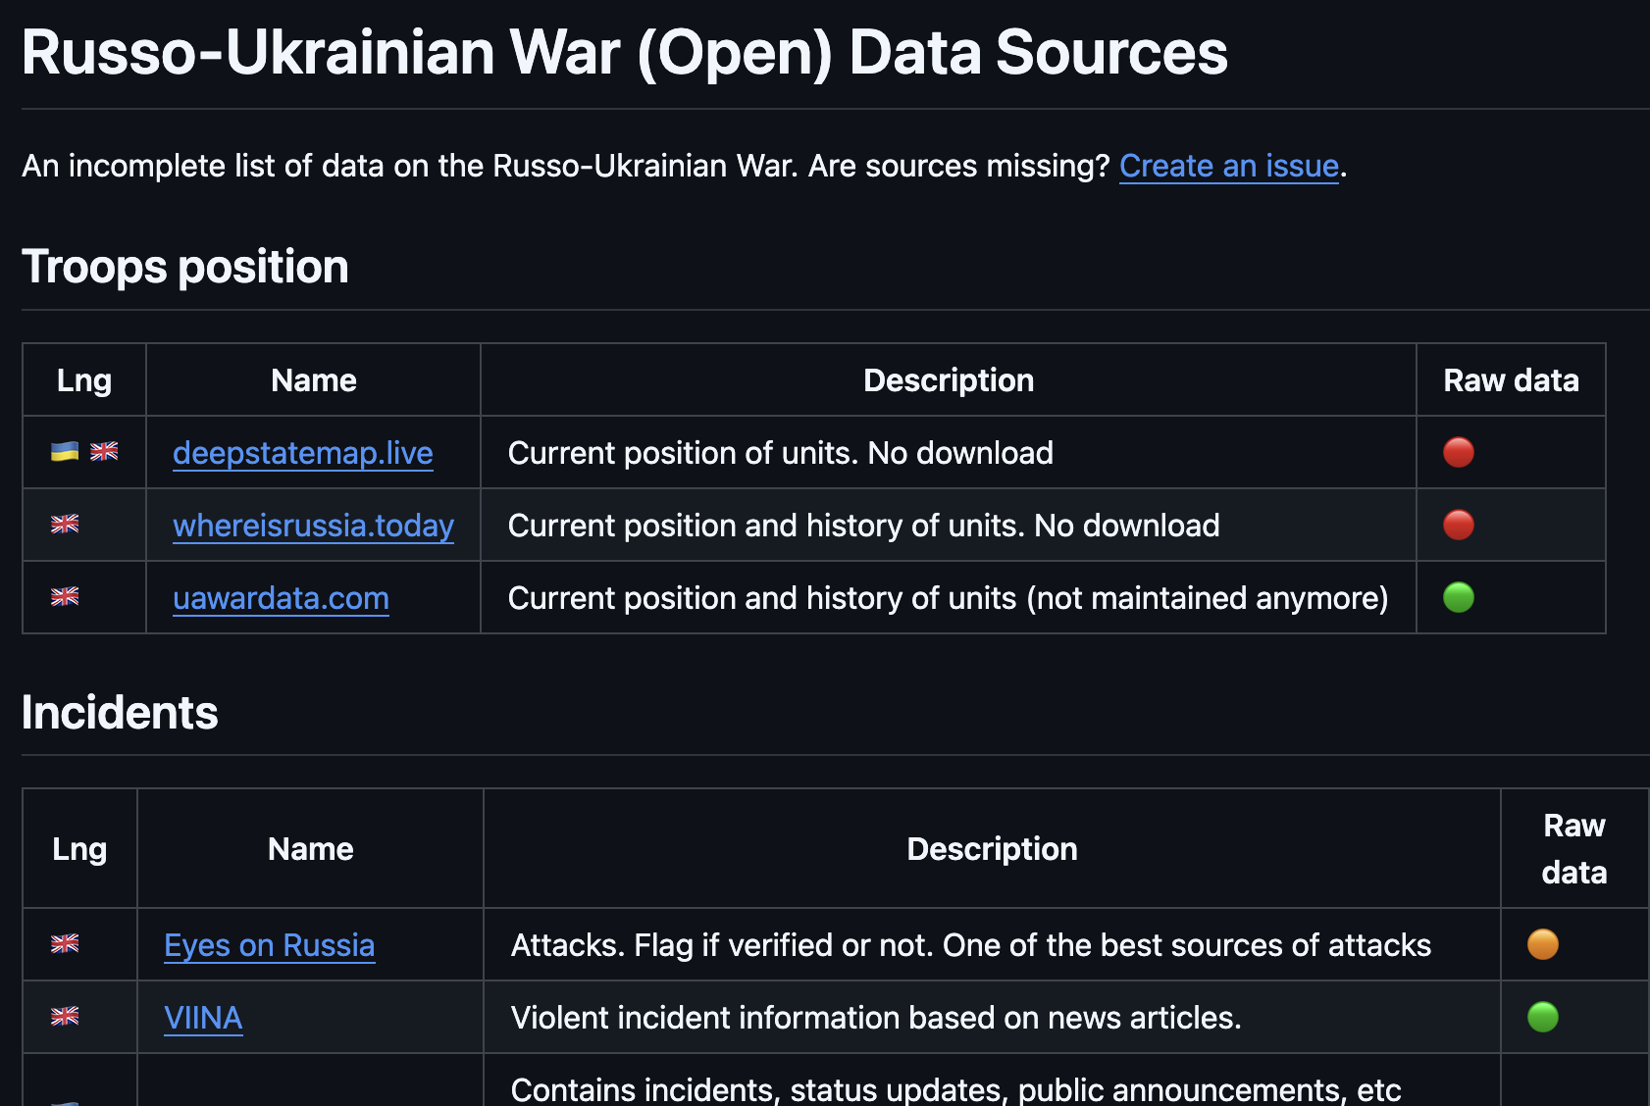
Data description
Primary source of data is the github repository maintained by GitHub user simonjuwiler.
Contains several types of data such as personell (killed, wounded) and equipment losses with cited sources.

Slide 6
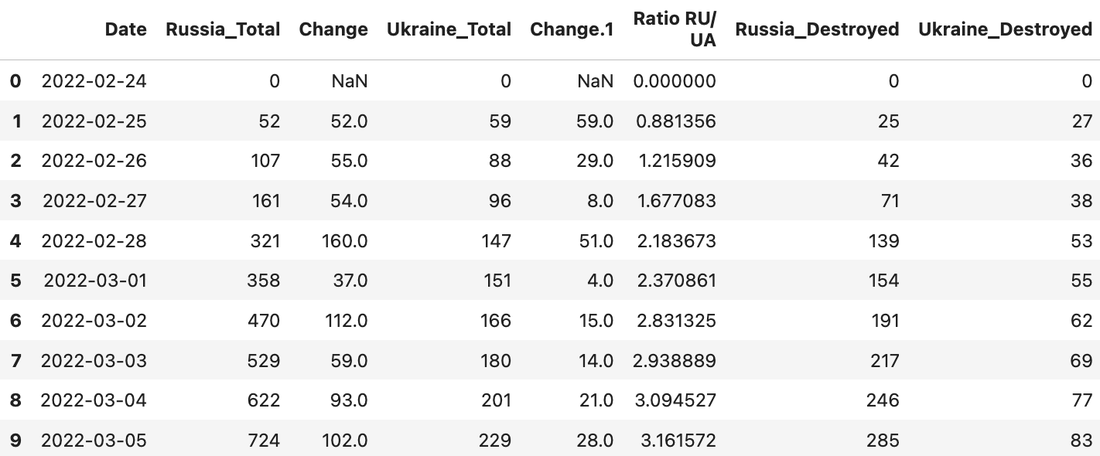
Equipment losses (Oryx’s site)
Contained cumulative count for different types of equipment loss for both sides
Starts from 2022-02-24 till 2025-05-05
67 columns

Slide 7
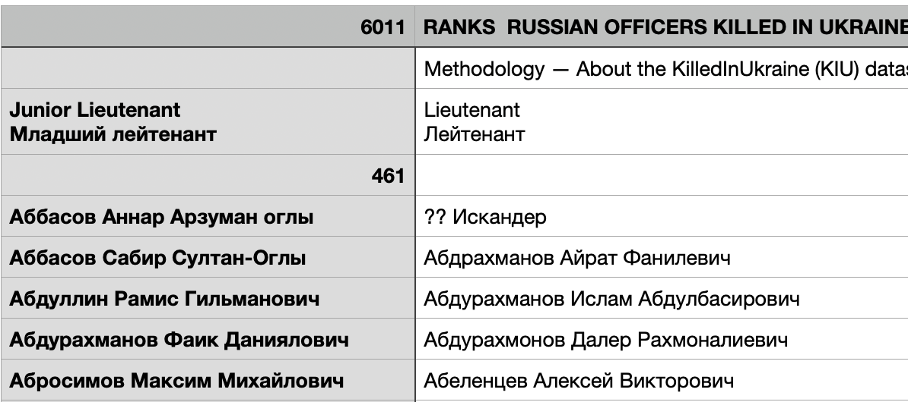
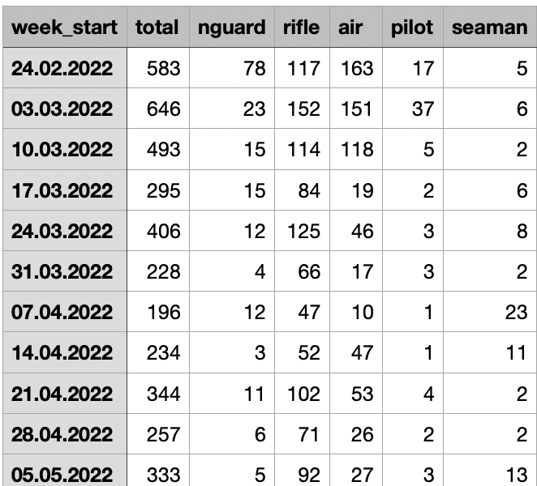
Russian personnel losses (Mediazona)
Russian Officers killed in Ukraine
https://github.com/simonhuwiler/russo-ukrainian-data-ressources.git
Russian losses in Ukraine per week https://en.zona.media/article/2025/04/25/casualties_eng-trl

Slide 8
Russian personnel losses (Mediazona)
Russian losses by rank
Russian losses by week
14 columns
23 columns

Slide 9
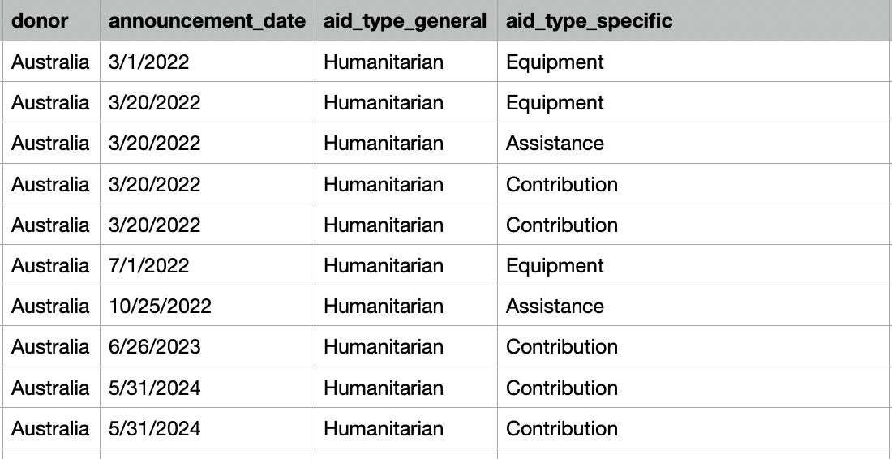
Financial aid to Ukraine (Support Tracker)
Captures humanitarian contributions from different countries to Ukraine as a response to this ongoing crisis
Fields available are: donor country, recipient country (Ukraine), the date of announcement, the sector of aid (for instance, Humanitarian assistance or Energy security) and funding amount.
85 columns

Slide 10
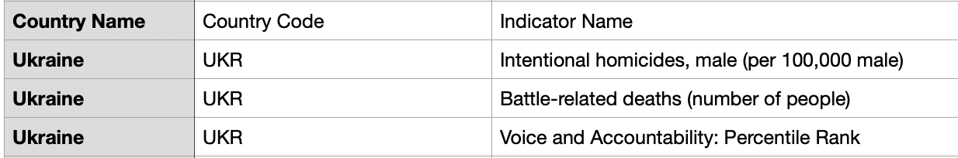
Economic indicators (World Bank Group)
Contains different economic indicators such as GDP, inflation, employment rate among others across different years
70 columns but 67 are years.

Slide 11
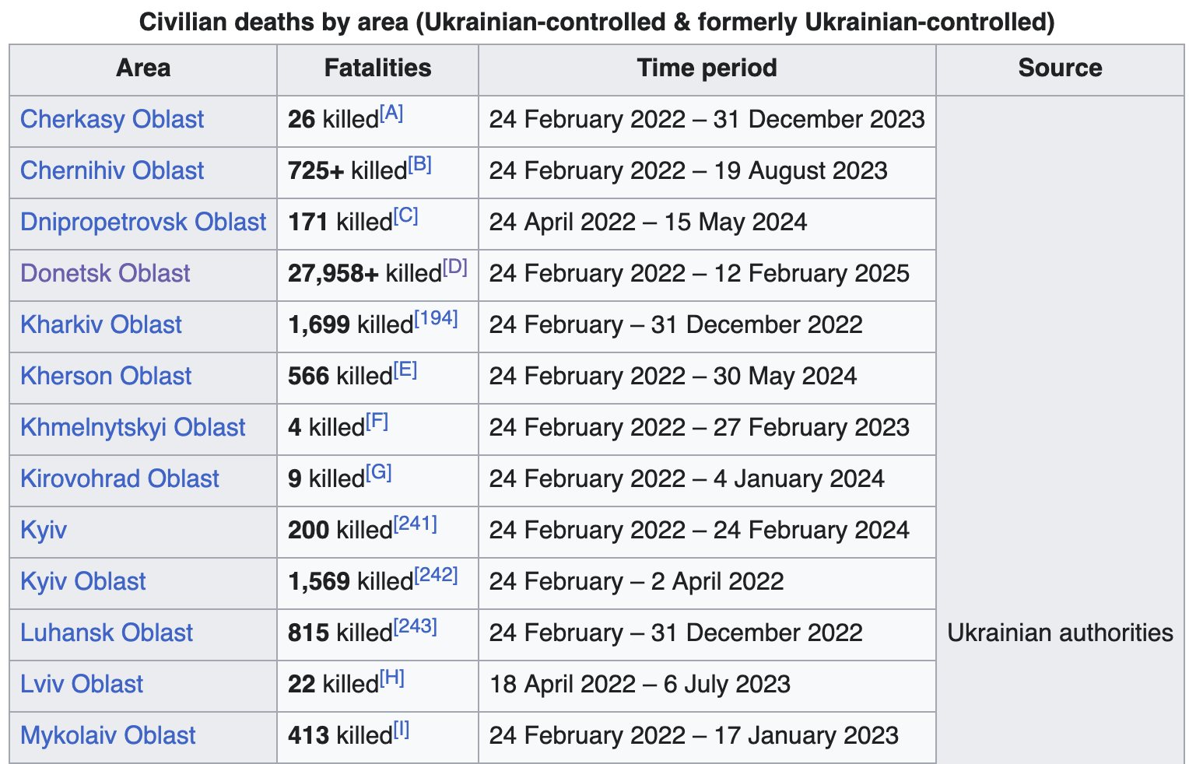
Ukraine and Russian civilian casualties (Wikipedia)
Retrieved from the Wikipedia article titled ‘Casualties of the Russo-Ukrainian War from the casualty section.
This data contains the total confirmed losses of civilians in different provinces of Ukraine and Russia.

Slide 12
Ukraine and Russian civilian casualties (Wikipedia)

Slide 13
Data preprocessing
Datetime conversion from string format to Datetime object - To facilitate time-series visualizations
Handling missing values (forward fill)
Key metric selection (those within our interest)

Slide 14
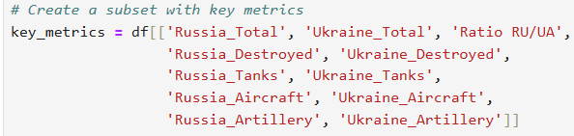
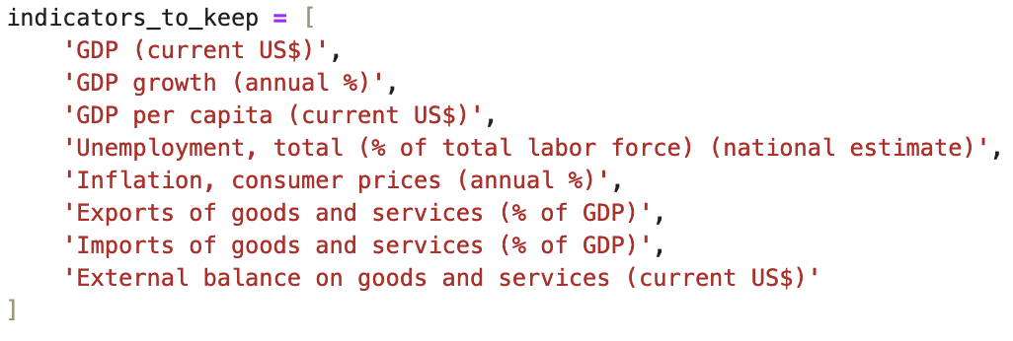
Columns selected
Equipment losses
Economic indicators

Slide 15
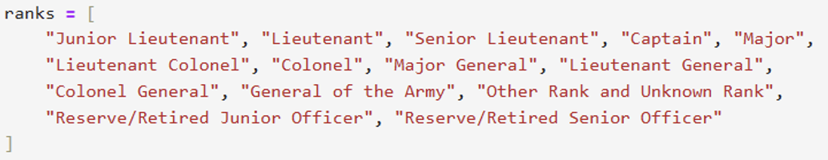
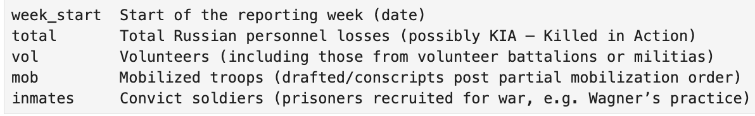
Columns selected
Officer loss Russian
Russian personell losses

Slide 16
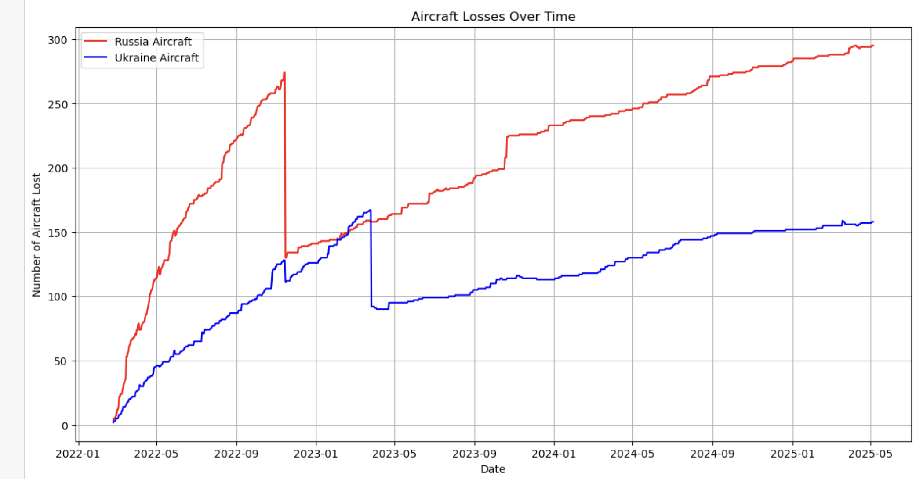
Exploratory data analysis
Unusual drop

Slide 17
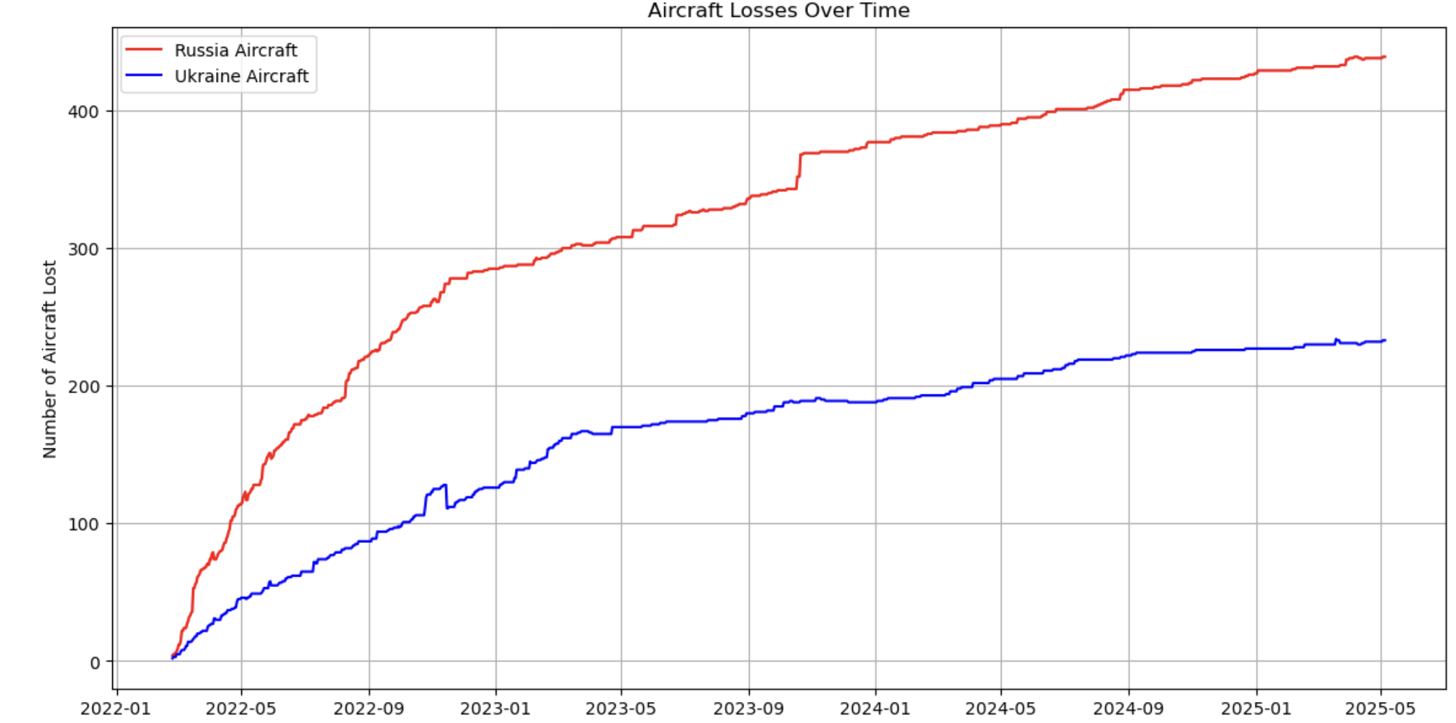
Exploratory data analysis
After fix

Slide 18
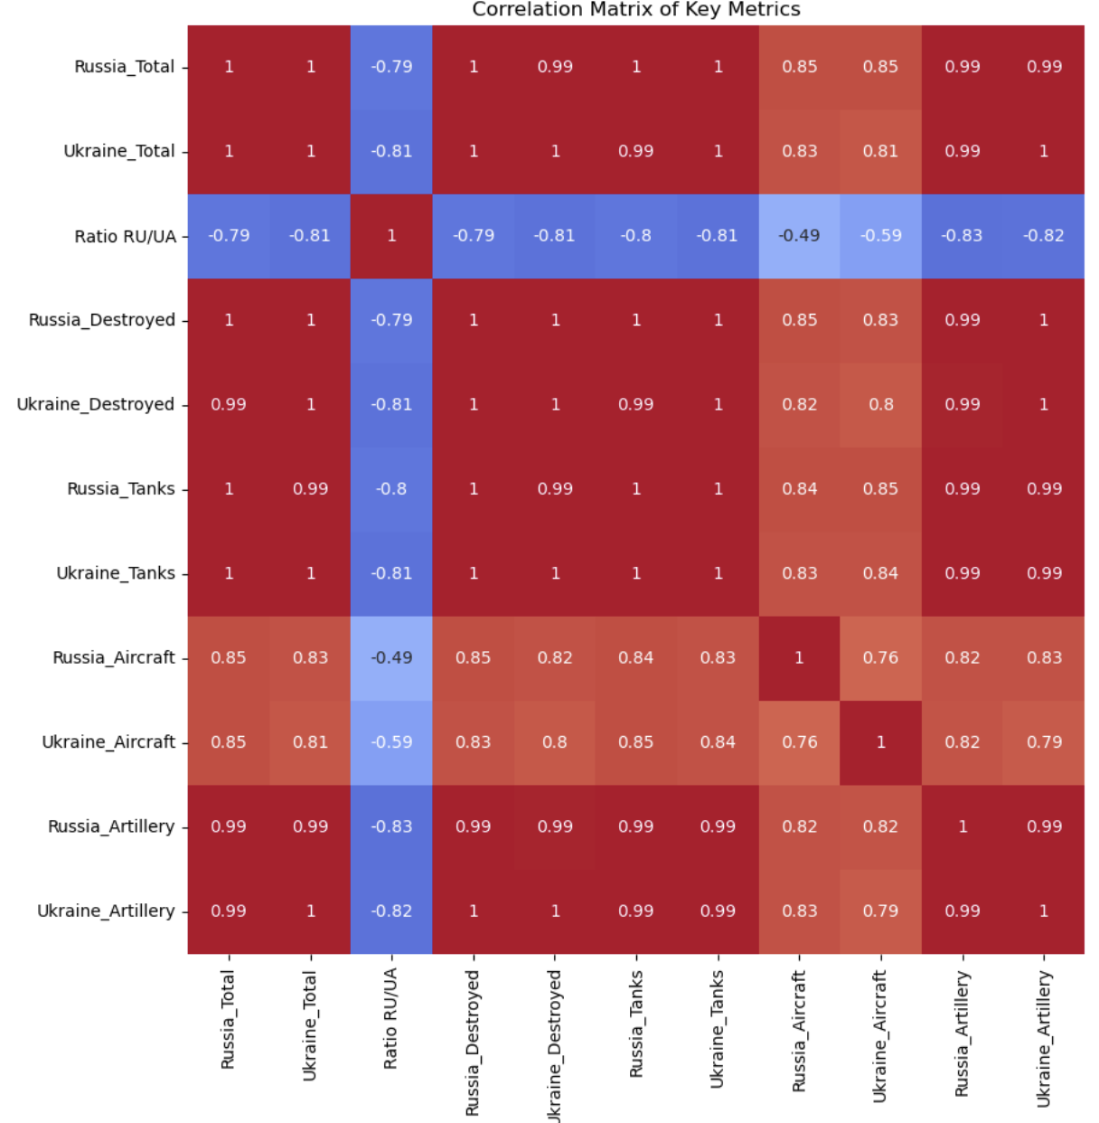
Suspicious perfect correlation

Slide 19
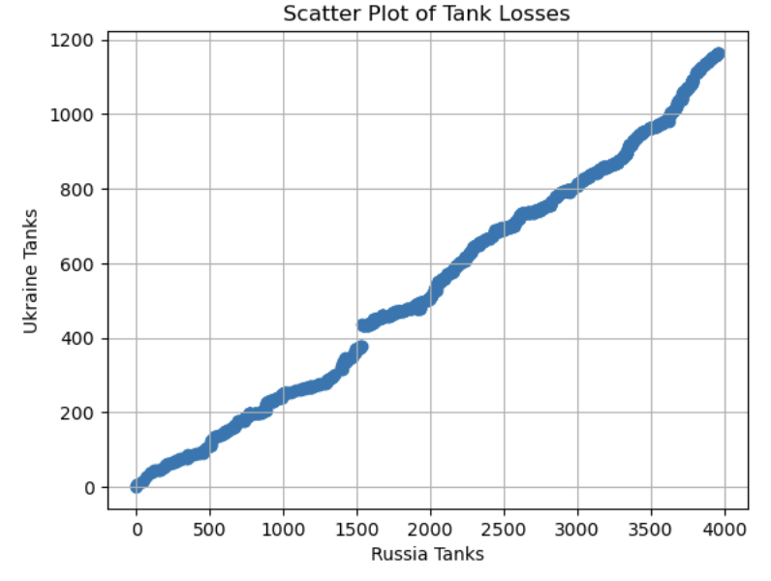
Suspicious perfect correlation
Symmetrical combat operations
Proportionate losses

Slide 20
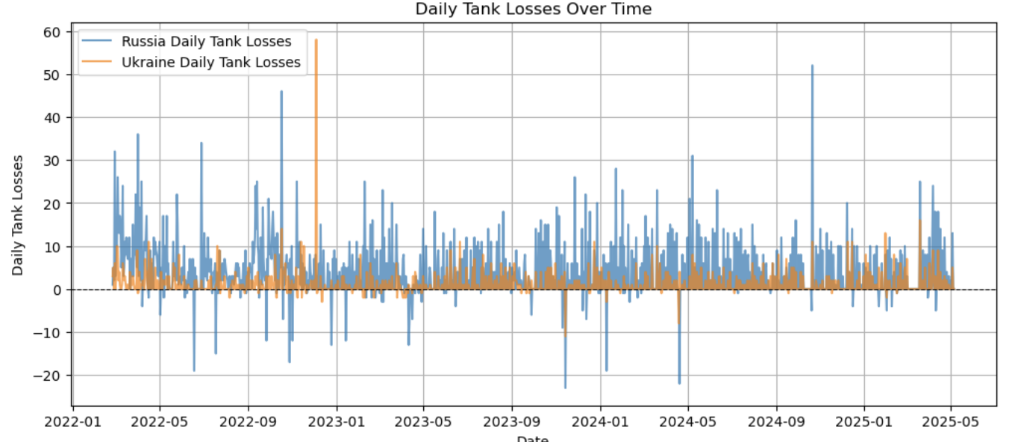
Exploratory data analysis
Daily tank losses contain negative values which are errors

Slide 21
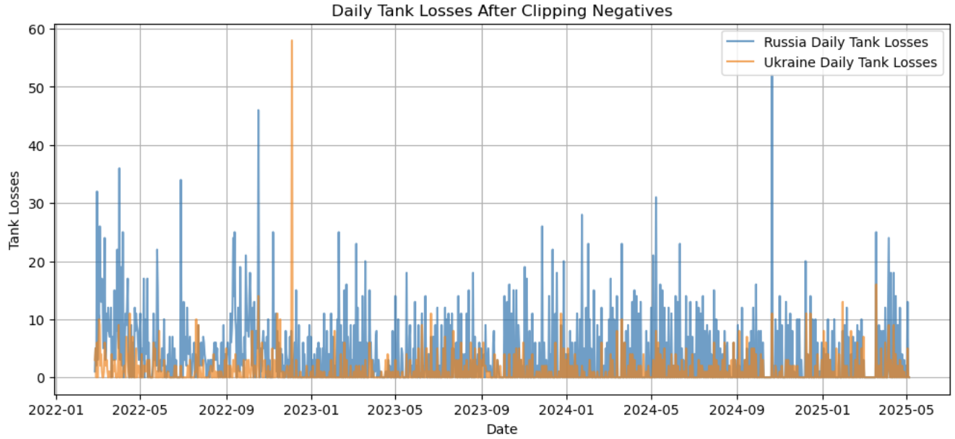
Exploratory data analysis
After fix

Slide 22
Predictive modelling
The correlation of total equipment losses with the number of days passed are as follows:
Correlation of Russia_Total with date: 0.9960
Correlation of Ukraine_Total with date: 0.9979
Therefore, linear regression was chosen to predict total equipment over the next time period.

Slide 23
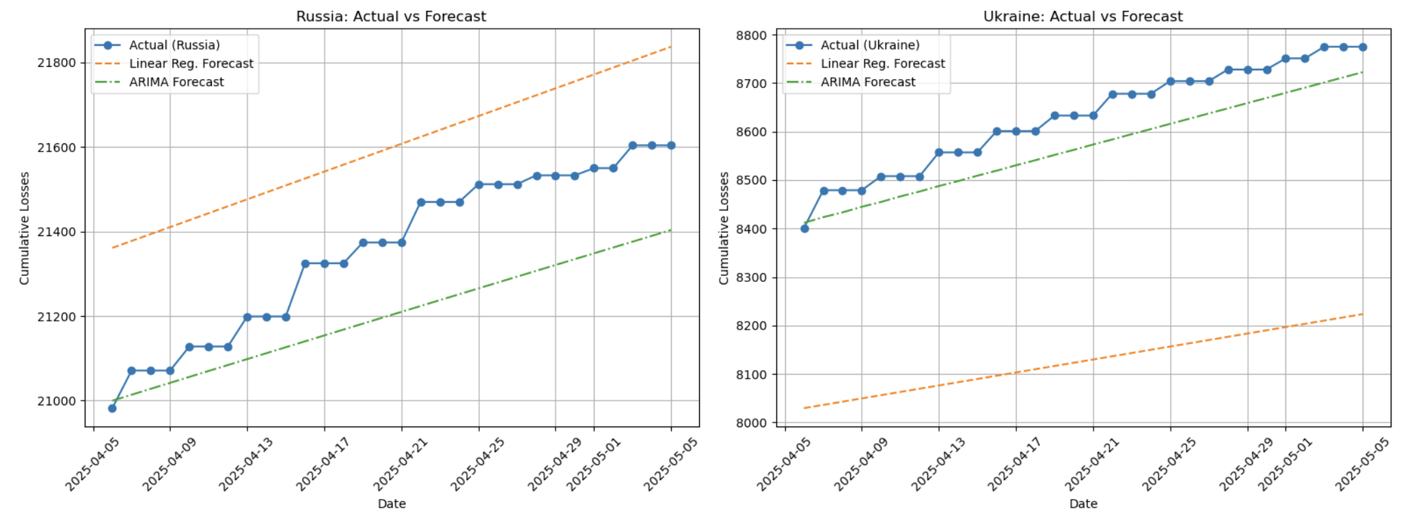
Predictive modelling
ARIMA (Autoregressive Integrated Moving Average) performed better than linear regression

Slide 24
Analysis
Dashboard

Slide 25
Conclusion
Significant equipment losses for Russia in comparison
Continuous economic decline for both countries
Both countries suffered significant losses
Russia suffered more compared to Ukraine during the war

Slide 26
References
Andersson, B. H. (2022). The agony of not knowing, as Mariupol mass burial sites grow. BBC News. Retrieved from sdfsdfsdfhttps://www.bbc.com/news/world-europe-63536564
GeeksforGeeks. (2024). Model Selection for ARIMA. GeeksforGeeks. Retrieved from sdfsdfsdfhttps://www.geeksforgeeks.org/model-selection-for-arima
Mediazona. (2025, April 25). Russian losses in the war with Ukraine. Mediazona count, updated. Mediazona. sdfsdfsdfhttps://en.zona.media/article/2025/04/25/casualties_eng-trl
NathOrmond. (n.d.). GitHub - NathOrmond/ukraine-war-data. GitHub. https://github.com/NathOrmond/ukraine-war-sdfsdfsdfdata.git
The Kyiv Independent. (2025, January 15). Retrieved from https://kyivindependent.com/russia-recruits-up-to-180-000-sdfsdfsdfconvicts-for-war-against-ukraine-foreign-intelligence-service-says
Trebesch, C., Bomprezzi, P., Nishikawa, T., & Kharitonov, I. (2025, April 6). Ukraine support tracker data. Kiel sdfsdfsdfInstitute. https://www.ifw-kiel.de/publications/ukraine-support-tracker-data-20758/

Slide 27
Wikipedia contributors. (2025, May 20). Casualties of the Russo-Ukrainian War - Wikipedia. sdfsdfsdfhttps://en.wikipedia.org/wiki/Casualties_of_the_Russo-Ukrainian_War#Total_casualties
World Bank Open Data. (n.d.). World Bank Open Data. https://data.worldbank.org/country/ukraine
sdfsdfsdf2022 Kherson counteroffensive. (2025, May 05). Wikipedia. sdfsdfsdfhttps://en.wikipedia.org/w/index.php?title=2022_Kherson_counteroffensive&oldid=1289005560

Slide 28
Thank You

